Slide 1
US Presidential Projections: 2024
ASU –VIRT-AI-PT-03-2024-U-LOLC-MTTH
Project 1
Presenters:
Krishan Fotedar
Cristina Frisby

Slide 2
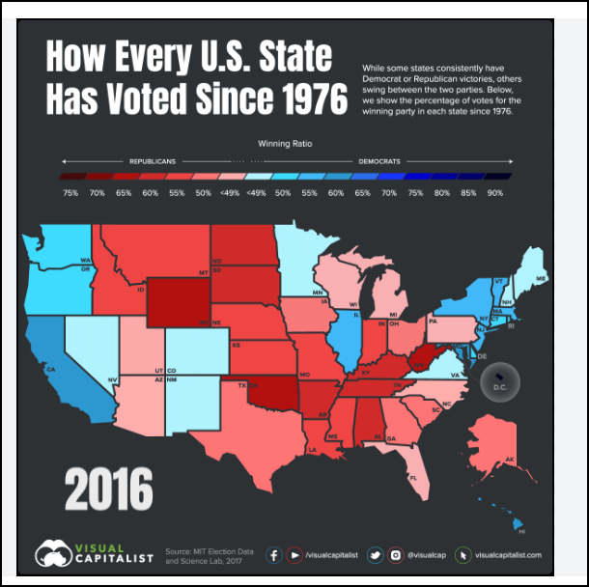
About THIS PROJECT
This project is an academic collaboration to meet the certification requirements of Project 1, Artificial Intelligence Bootcamp.
Presenting Students: Cristina Frisby & Krishan Fotedar

Slide 3
Why Attempt to Predict and Understand Election Results?
Impact
Financial
Personal
Global

Slide 4
Part 1: Predicting general election outcomes based on historical results
Analysis Consisted of two Projects:
1/ Historical Election Results: Run a Prophet time series on presidential election data by state spanning 1976-2020
2/ Bellwether Counties: Run a Prophet time series on the results of 44 ‘bellwether’ counties. Bellwether is defined as a county whose presidential election results match the national vote in all but one election since 1980

Slide 5
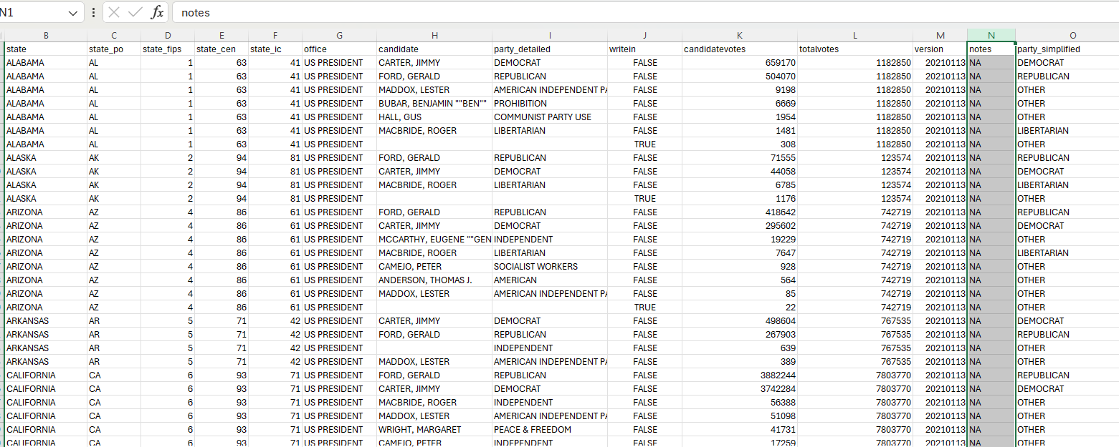
Historical ELECTION RESULTS – DATA PREPARATION Predicting Presidential Election Results by State
Data Source listed presidential results by candidate for each state
from 1976 to 2020
Part of data cleaning was to get the results into 3 buckets:
Democrat
RepublicanOther

Slide 6
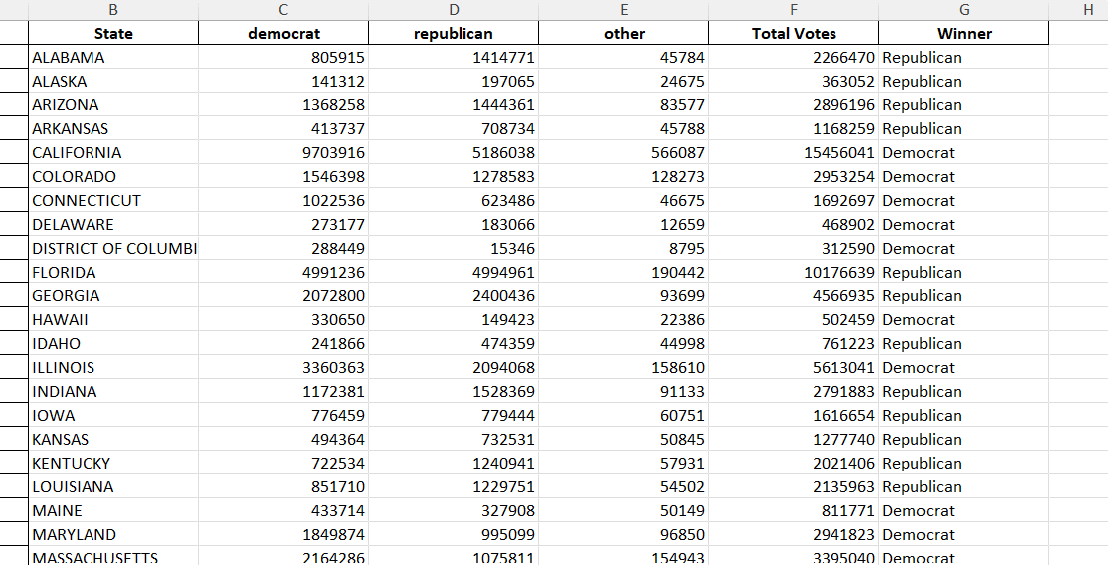
Historical ELECTION RESULTS -2024 Results Predicting Presidential Election Results by State
Ran a Prophet model for each state and each party
Stored results in a dictionary with the state as the key and the value being a 3 element
list with the element being a time-series results for each party
Cycled through the dictionary and identified the 2024 predicted outcome and
labeled the winner
Predicted Popular Vote Result: D – 51%, R – 46%, O-3%
Predicted Electoral Result: D -272, R-262

Slide 7
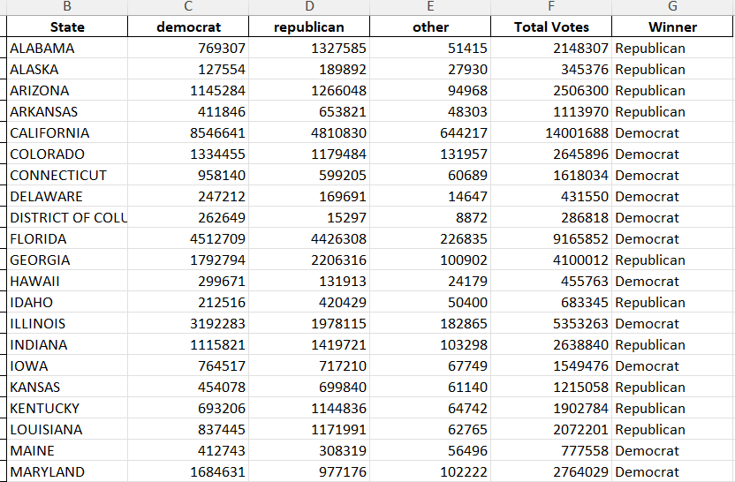
Historical ELECTION RESULTS – 2020 RESULTS Predicting Presidential Election Results by State
Ran a Prophet model to predict the 2020 vote and compared it to the actual 2020 outcome
Model 2020 Popular Vote Result: D – 50%, R – 45%, O-5% , Under-predicted D and R by 1%
Missed on the following states: AZ (R), GA (R), OH (D), IA (D)

Slide 8
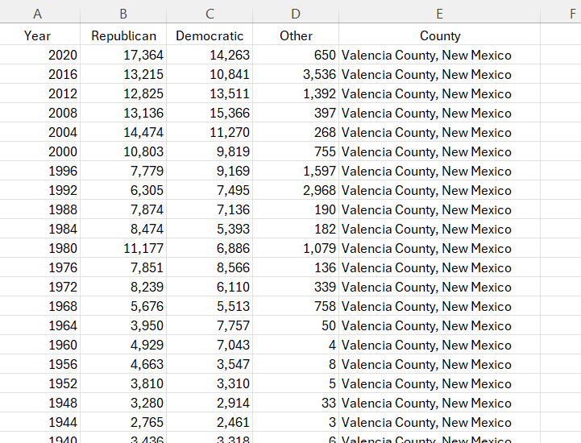
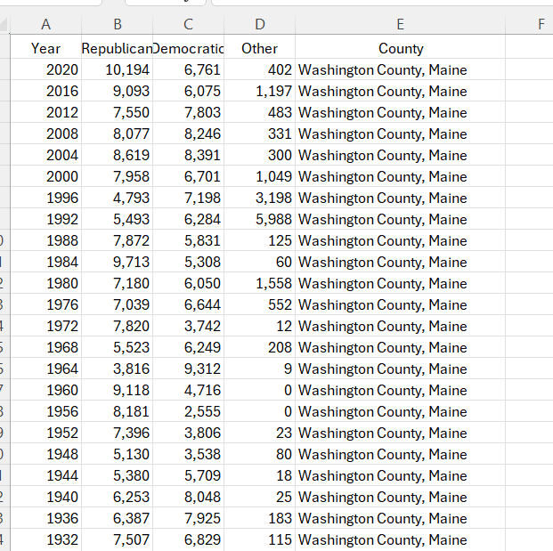
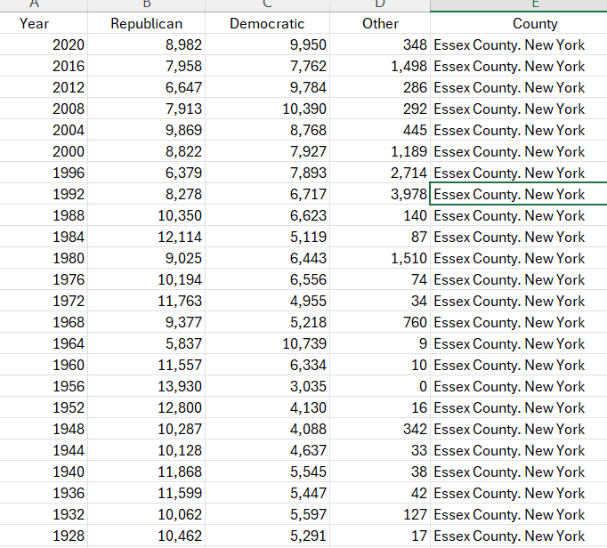
bellwether ELECTION RESULTS – DATA PREPARATION
44 counties have predicted the winner of the presidential election in all but one
election since 1980
Found the data in Wikipedia - filled a 44-tab spreadsheet
Data goes back to the 1880s in some cases, but we only used data since 1980

Slide 9
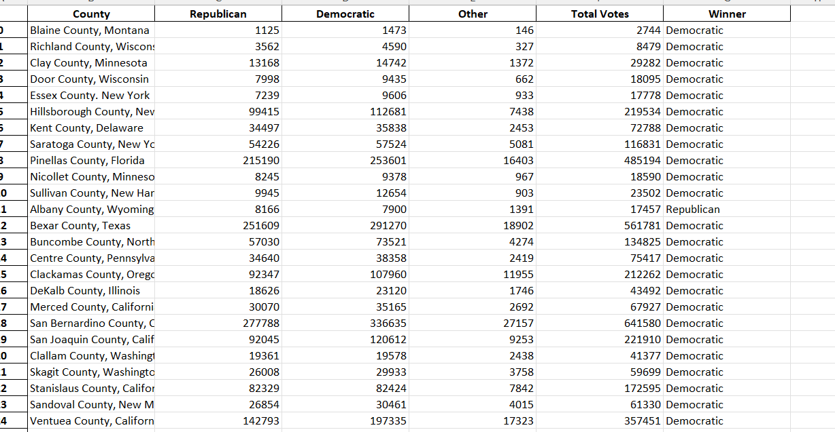
bellwether ELECTION RESULTS – 2024 Results Predicting Presidential Election Results
Ran a Prophet model for each county and each party
Stored results in a dictionary with the county as the key and the value being a 3-element
list with the element being a time-series result for each party
Cycled through the dictionary and identified the 2024 predicted outcome and
labeled the winner
Model is showing 38 counties will vote Democratic, 6 will vote Republican

Slide 10
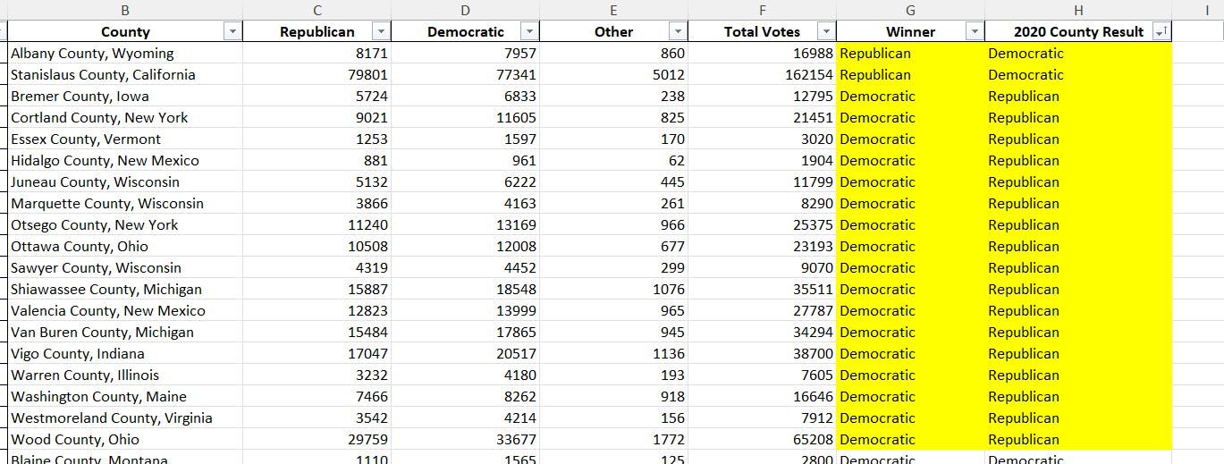
bellwether ELECTION RESULTS – 2020 Results Validate the model
Ran a Prophet model for each county and each party to predict 2020 results
Compared the model 2020 results with 2020 actuals
Missed on 19 of the 44 counties – 2(R), 17(D)
The last 2 election cycles (2016 and 2020) have seen 34 of the 44 misses for these counties
Bellwether counties may no longer be good predictors of national vote outcomes

Slide 11
Part 2: Accessing Voter Demographics through Poll Data
Pew Research Center conducts public opinion polling, demographic research, computational social science research and other data-driven research.
“Party Identification Tables” for 1994 through 2023 were used to investigate demographics including Gender and Race/Ethnicity

Slide 12
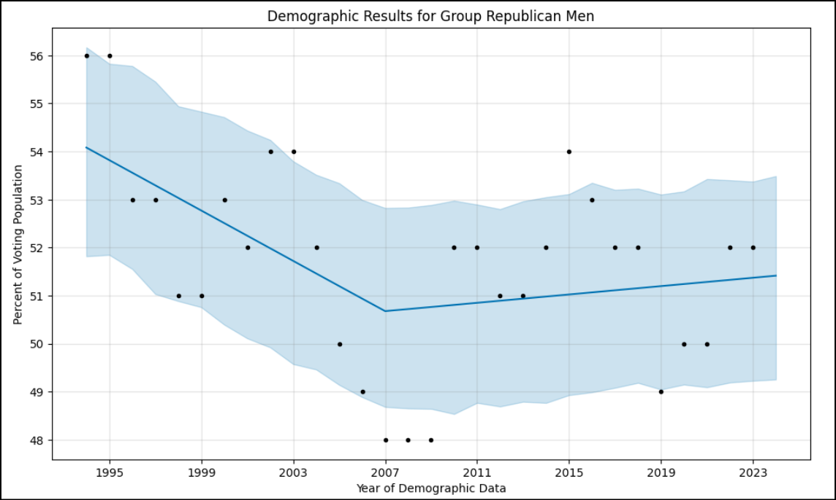
Demographic Analysis Using Prophet Models for 2024 Predictions
Prophet Predictions into 2024 for each demographic group.
Sample: “Republican – Men”

Slide 13
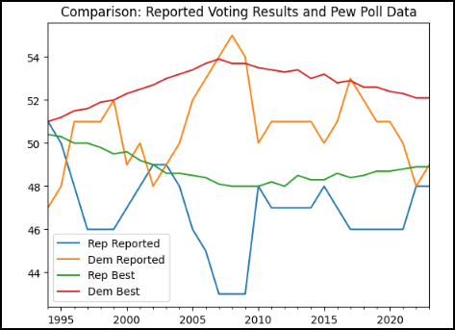
Results Actual Election Results vs Polls (Pew): 1994 through 2023
General Comparison:
Primary Party Candidate Voting Results vs. Predicted Model From Poll Results using “prophet” models
Variances and Similarities:
Disrupter - 2008 Anomaly (Barack Obama)

Slide 14
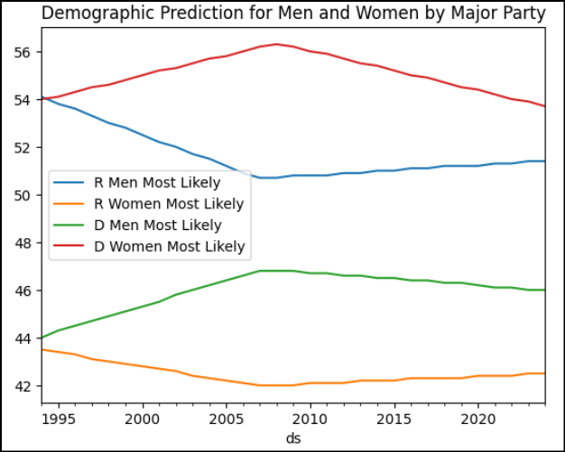
Results Pew Poll Models 1994 through 2024 Demographic: Gender (Men & Women)
General Comparison:
Polling Data Model from 1994 through 2023 and “prophet” prediction for 2024
Variances and Similarities:
Three of 4 groups show little change after 2008 (less than 1%): Stable
One Group indicates a negative trend of more than 2%: Democrat Women
Conclusions:
The Democratic Party should focus on the women’s declining demographic.

Slide 15
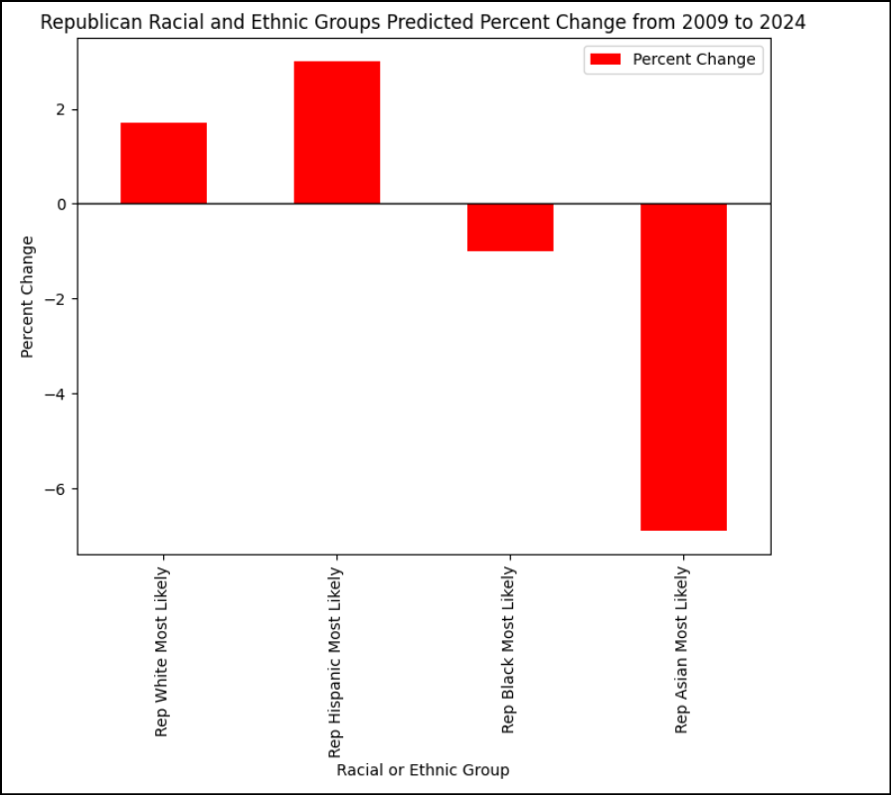
Results Pew Poll Models 1994 through 2024: Demographic: Racial and Ethnic Groups
2024 Impact:
Slightly Upward: White and Hispanic Republican Voters
Slightly Downward: Black Republican Voters
Significantly Downward: Asian Republican Voters
Should The Republican Party focus on Asian Voters to disrupt the trend?
Who are Asian Voters and what are their issues? How diverse is this demographic?

Slide 16
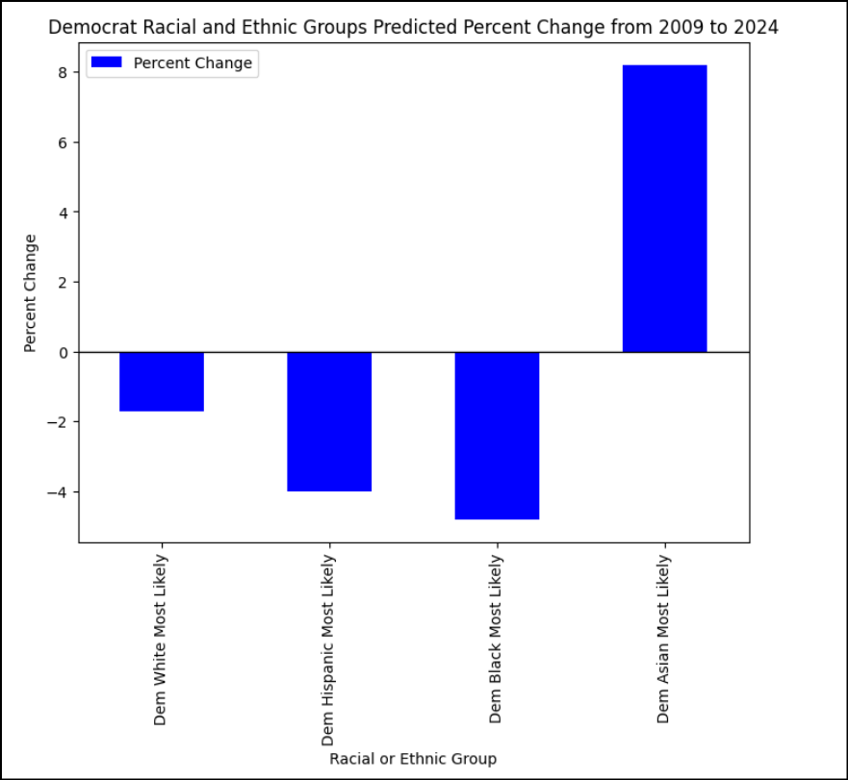
Results Pew Poll Models 1994 through 2024 Demographic: Racial and Ethnic Groups
2024 Impact:
Significantly Upward: Asian Democrat Voters
Slightly Downward: White Democrat Voters
Significantly Downward: Hispanic and Black Democrat Voters
Conclusions:
The Democratic Party can focus on Black and Hispanic voters to disrupt the trend.

Slide 17
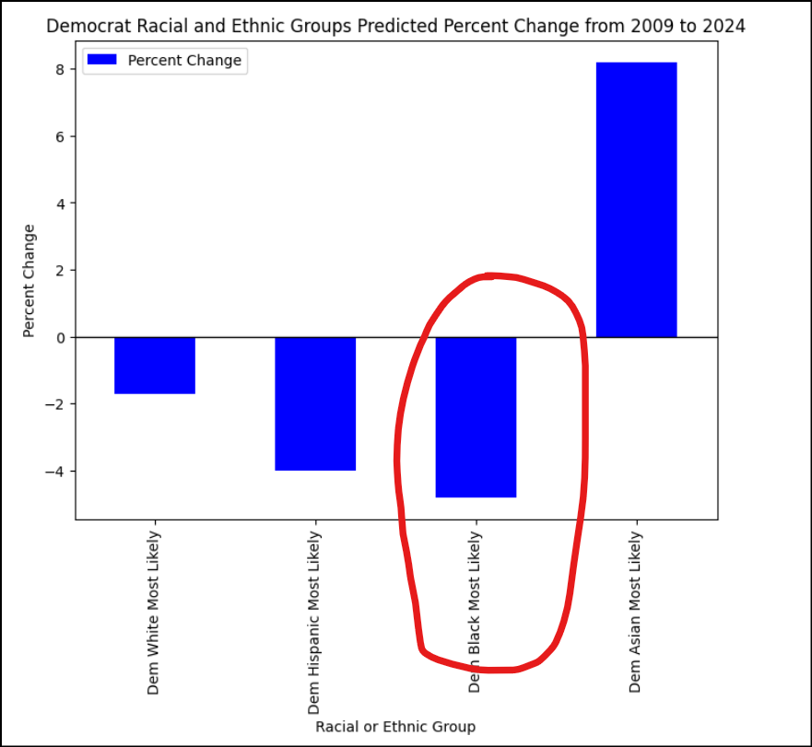
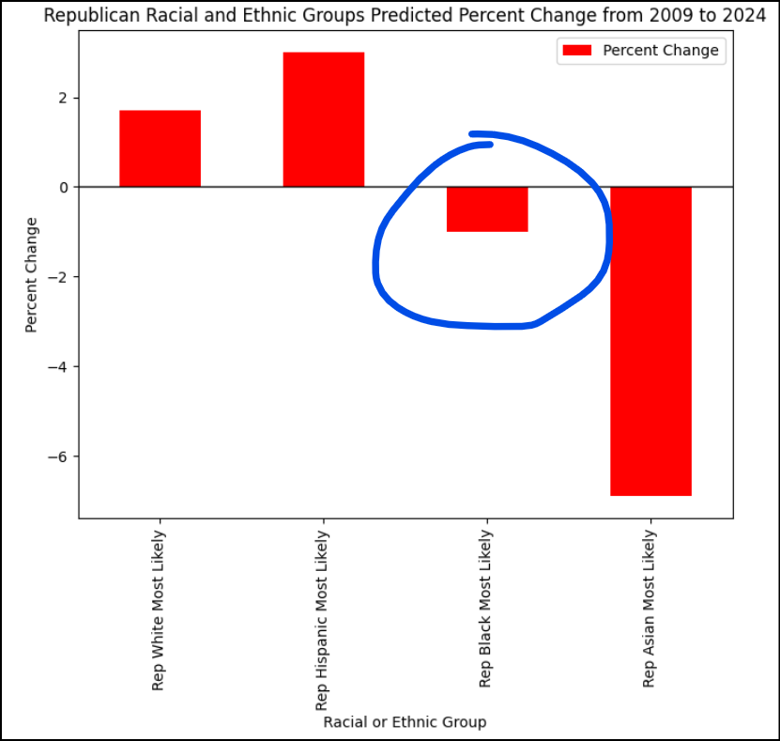
Results Pew Poll Models 1994 through 2024: Demographic: Racial and Ethnic Groups
Voting “Swap”:
White, Hispanic and Asian demographics are “swapping” similar percentage points on Republican and Democrat Parties.
Where are the Black voters going? Black voters trending negative both Democrat and Republican.
Are Democrats more impacted by the trend than Republicans?
Conclusion: Black voters may be voting independent or not voting.

Slide 18
Summary
Elections can be greatly influenced by historic events, but patterns do emerge in the trends.
Which way are the election results trending?
Historically, which areas most likely predict the national winner?

Slide 19


And The Winner is: Joe Biden

Slide 20
Thank you

